Slide 1
POWER MANAGEMENT SYSTEM
BY
Author: Siva Surya M, Suganth M , Sanjeeva S
Internship: National Institute of Ocean Technology (NIOT), Chennai
Department: Ocean observation system
NIOT Date: 27/06/2025

Slide 2
Project Overview
Objective:
To Design a power management system.
To monitor the real time voltage and current in the power sources.
Automatically switch between a LeadAcid and a LithiumIon battery based on realtime voltage levels.
Significance:
Applicable in ocean buoys, remote IoT setups, disaster communication systems.
Lowcost, highefficiency energy utilization.
Monitors voltage and current of:
LeadAcid Battery (12V)
LithiumIon Battery (14.7V)
Solar Panel (40W)
Load consumption.
Autoswitches power source using Relay.
Displays realtime data on LCD display.
Also Logs data to device via Serial monitor.

Slide 3
Components Used
Microcontroller: ESP32 DevKit V1
Power Sources:
Charge controller
LeadAcid Battery (12V)
LithiumIon Battery (14.4V)
Solar Panel (40W)
Load(motor)
Conversion & Switching:
Buck Converter (12V to 5V)
Relay Module 5V (1channel)
Sensing Modules:
ACS712 Current Sensors (30A, x4)
Display: 16x4 I2C LCD
Protection: Diodes, Fuses

Slide 4
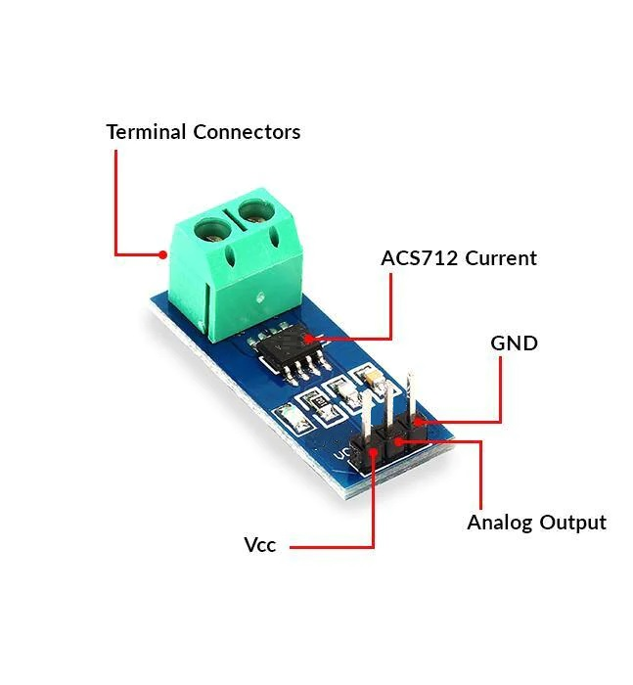
🔌 ACS712 Current Sensor (20A)
The ACS712 is a precise current sensor used for measuring both AC and DC current.
It provides a clean analog voltage output proportional to the current flowing through it.
Sensor image :

Slide 5
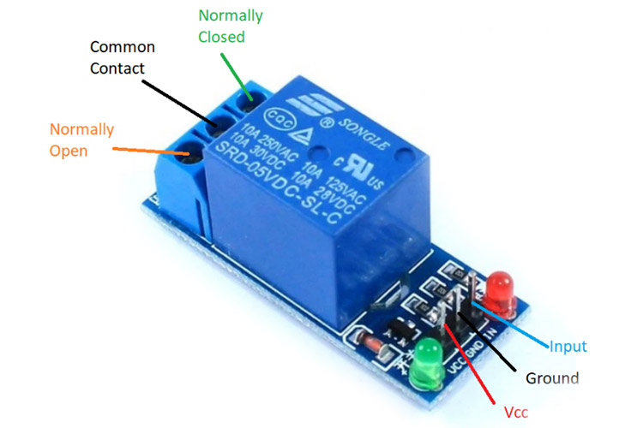
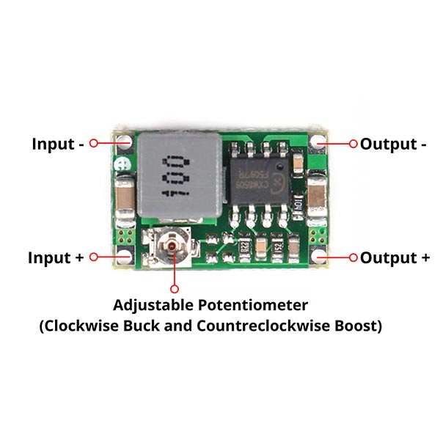
COMPONENTS
Relay 5v (single channel
)
Buck converter (3A)

Slide 6
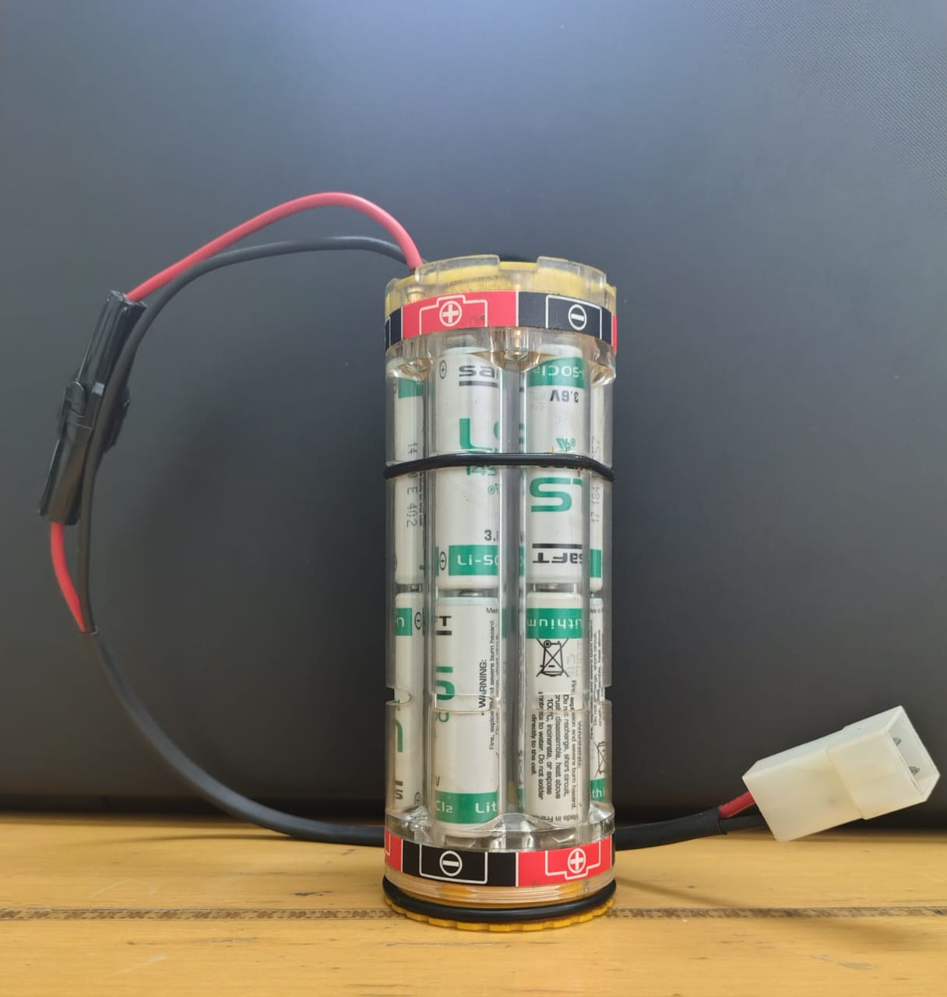
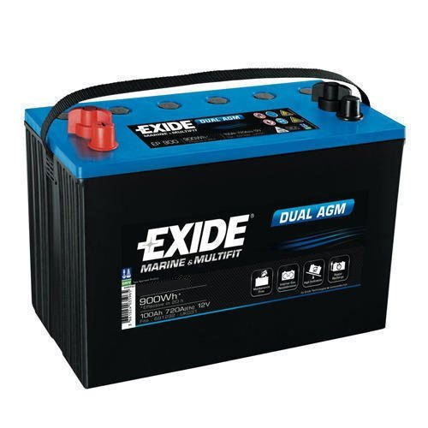
Components
Lithium ion battery 14.7 v
Lead acid battery 12v

Slide 7
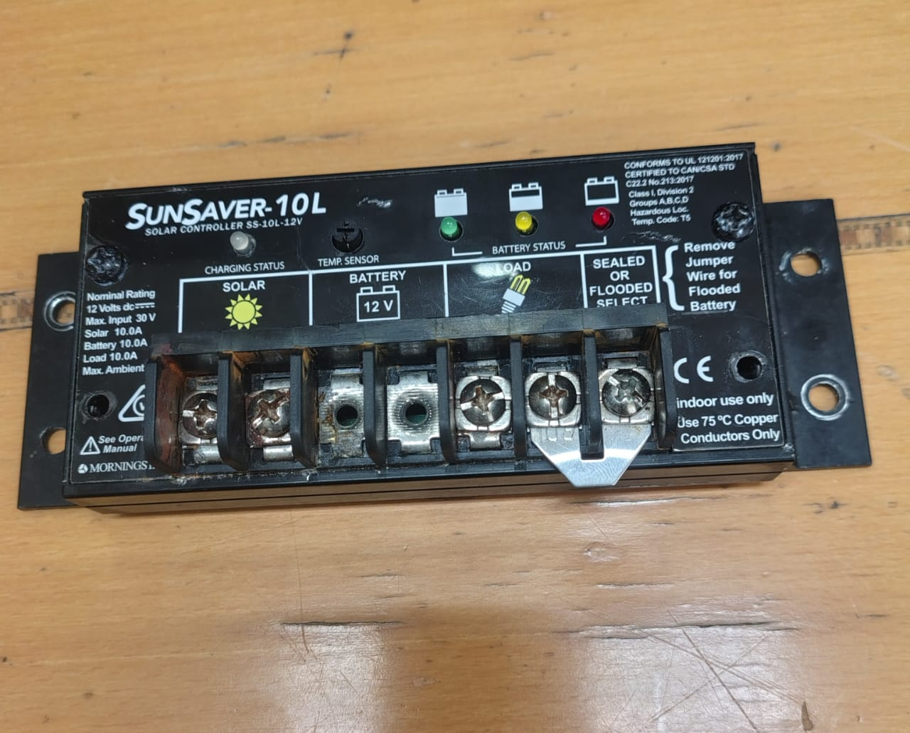
Solar Charge Controller :
Regulates the voltage and current coming from the solar panel Ensures safe charging of the lead-acid battery.
Prevents overcharging, reverse current, and deep dischargeActs as an intermediate power distribution system to both battery and load.

Slide 8
🛠How it works ?
The system continuously monitors the voltages and currents of the Lead-Acid battery (12V), Li-ion battery (14.7V), and the 40W Solar Panel using voltage and current sensors.
💡 Solar Charging: During sunlight hours, the solar panel charges the batteries while powering the load.
🔄 Automatic Battery Switching:A relay circuit, controlled by the ESP32, automatically switches between batteries based on real-time voltage levels
If Lead-Acid battery drops below 12V, the system switches to the Li-ion battery.If Lead-Acid battery recovers above 12V, it switches back for primary use.
▶ 📊 Sensor Readings: ACS712 (30A) current sensors and voltage sensors measure all power sources and the load in real time.
▶ 💻 Data Display & Logging: Values are shown on a 16x4 LCD display.Simultaneously, data is transmitted via Wi-Fi and logged on a connected device for remote monitoring

Slide 9
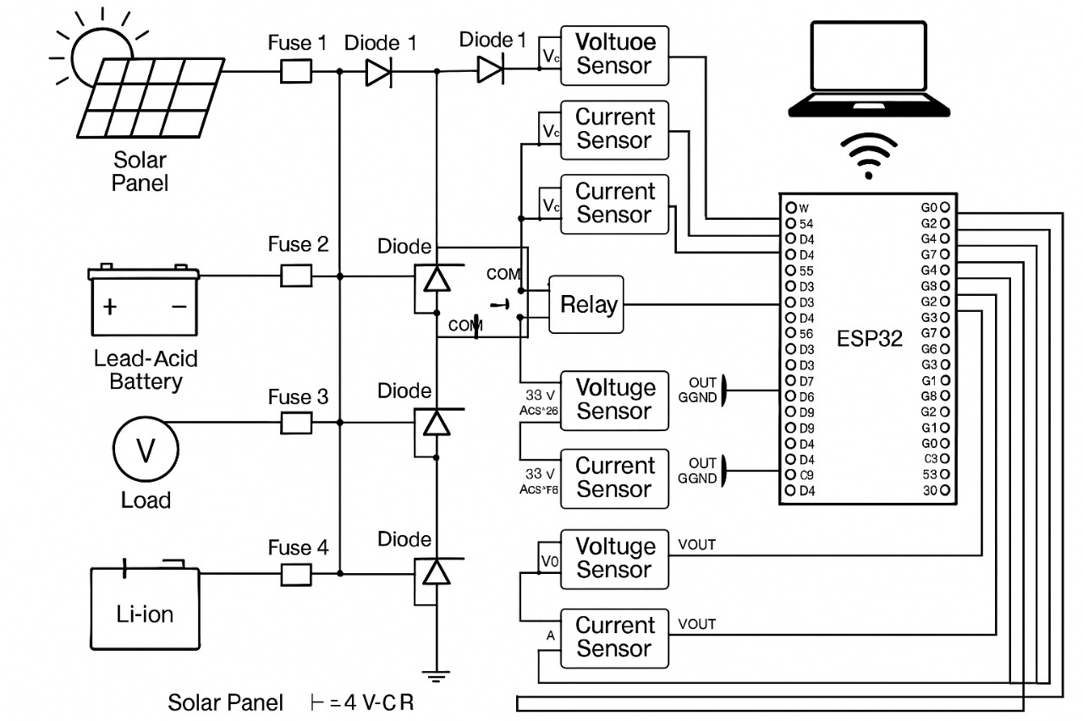
Diagram:
q

Slide 10
Safety Considerations
Fuses: 10A blade fuses on battery & solar +ve terminals
Diodes: Schottky diodes to prevent reverse current
Voltage Divider: Keeps ESP32 safe from >3.3V
Common Grounding: Prevents sensor errors

Slide 11
THANK YOU

